Slide 1


T24 Induction Training
Infobasic Programming

Slide 2
Agenda
Introduction to Infobasic
Arrays and types of arrays
Introduction to subroutines and programs
Important functions/commands in Infobasic
Steps to create a subroutine in T24
Compiling and cataloguing routines and programs
T24 routines – file operations
T24 – Routines with arguments

Slide 3
Introduction to Infobasic
T24 core & local developments are written in Infobasic.
Infobasic is a simple however powerful programming language.
Simple – English like statements
No declaration of variables is required and all variables in Infobasic are treated as dynamic arrays.
No data type specification is required
All variables by default have infinite variable length
  Multi value
  Sub Value

Slide 4
Structure of the Subroutine/Program
  There are 2 different types of programs in Infobasic:
1 is a ‘PROGRAM’ and the other is a ‘SUBROUTINE’.
  Any program executed from the jSH/cmd/$ prompt is termed as a ‘PROGRAM’
  A program executed within T24 is termed as a ‘SUBROUTINE’.
  Usually, any program or subroutine developed by the user is stored under a directory in UD with the suffix BP (eg SYN.BP)
  The core T24 programs or subroutines are stored under t24lib, only the compiled class files will be present and not the source code.
  All subroutines have to begin with the line
  SUBROUTINE <<Name of the routine>> and end with RETURN and END. The subroutine name and the name of the file where the subroutine is to be stored must have the same name.
  Insert files are similar to ‘Include’ files that you might have used in ‘C’ program. There are number of insert files available. Each one of them contains some inbuilt functionality that can be used in your programs/subroutines. This enables re-usability of code.

Slide 5
Array
Each variable that we use occupies a portion of the memory.
Usually character variables occupy 1 byte of memory, having the capacity to store just one character.
In case a sequence of characters has to be stored, then a character variable would not be sufficient. And hence the arrays are required.
Array is a continuous memory blocks in order to store the string.
Sequential storage of characters that form a string will make storage and retrieval faster and easier.
  Example: Arrayname1
  S A M P L E
  0 1 2 3 4 5
To retrieve ‘A’ in ‘SAMPLE’ , specify Arrayname1[1]

Slide 6
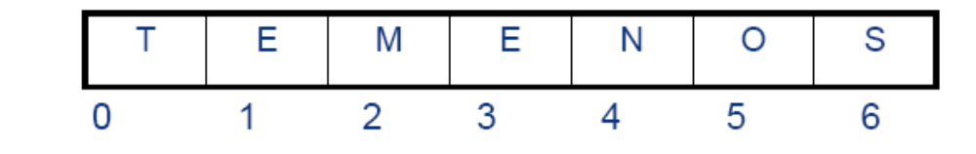
Array Cont’d
Continuous allocation of bytes
All bytes in an array have the same name as that of the array
Each byte is uniquely identified with the help of a subscript.
Types of Arrays
  There are two different types of arrays that are supported by Infobasic.
  They are: 1 Dynamic Arrays
        2 Dimensioned Arrays

Slide 7
Array cont’d
Dynamic Arrays
  Dynamic in nature
  Variable length
  Need not be declared
  Can hold any type of data
  Automatically increase or decrease in size depending on the data
  All variables in Infobasic are dynamic arrays
Dimensioned Arrays
  Have a fixed number of rows and columns
  Can hold any type of data
  Needs to be declared
  Used when dimensions and extents are known and are not likely to change

Slide 8
Array cont’d
Dynamic Arrays
CUSTOMER.NAME = ‘’
RATE = 0
DATE = “121202”
Can store any type and any amount of data.
Only initialization is required.
  Uses delimiters to store data of various fields
  ASCII Decimal Description
  254 Field Marker
  253 Value Marker
  252 Sub-Value Marker

Slide 9
Array cont’d
How data is stored in Dynamic Array:
  If the above sample record was to be stored in a dynamic array, it would be as follows:
FIELD | VALUE
1 MNEMONIC | MNE
2.1 SHORT.NAME | MDL BANK
2.2 SHORT.NAME | R09
3. 1 GB NAME.1 | MODEL BANK
...
40.1. 1 EMAIL.ADDR(LOCAL.REF.FIELD) | Email1
40.1. 2 EMAIL.ADDR(LOCAL.REF.FIELD) | Email2
40.1. 3 EMAIL.ADDR(LOCAL.REF.FIELD) | Email3
MNEFMIMDL BANKVMR09FMMODEL BANKFM... FMEmail1SMEmail2SMEmail3

Slide 10
Array cont’d
Dimensioned Arrays
  Dimensioned array provide more efficient means of creating and manipulating tables of data elements where the number of dimensions and the extent (number of elements) of each dimension is known and is not likely to change.
  Dimensioned arrays have to be declared using the DIMENSION statement.
Example
  To declare a dimensioned array use DIM ARRAY1(4,3)
  4 - > Refers to the number of rows
  3 - > Refers to the number of columns

Slide 11
Array cont’d
Also single dimensioned arrays could be created. This type of dimensioned arrays will only have a fixed number of rows. The number of columns will be unlimited. In this case, each row in the dimensioned array will be a dynamic array.
DIM ARRAY2(4)
4 - > Refers to the number of rows
Columns - Unlimited

Slide 12
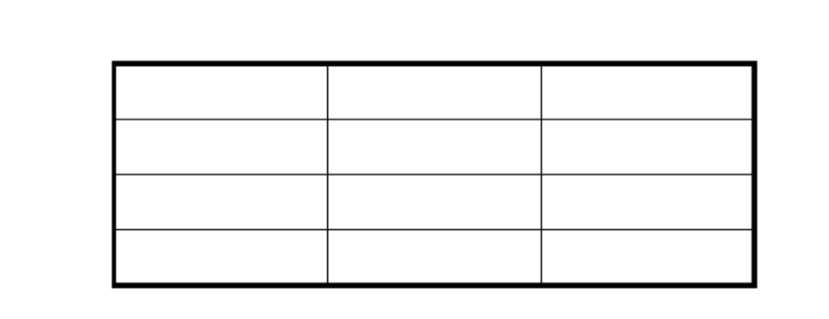
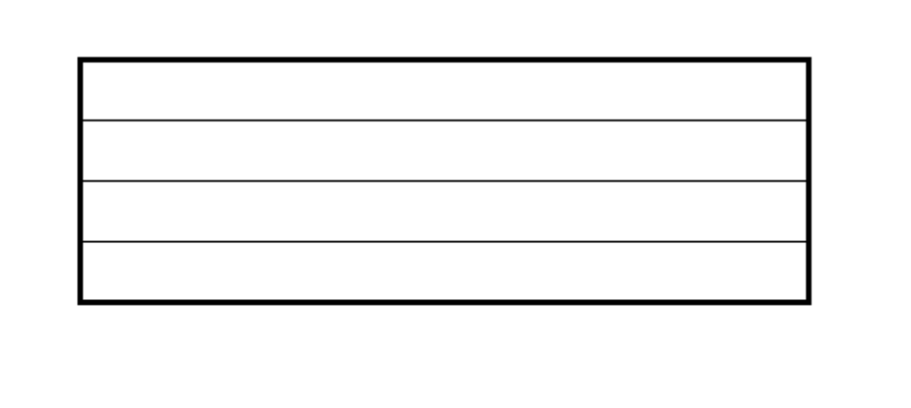
Array cont’d
DIM ARRAY1(4,3) DIM ARRAY2(4)
4 – Rows 4 – Rows
3 – Columns (Each row will be a dynamic array)

Slide 13
Structure of the Subroutine/Program
Most commonly used insert files are I_COMMON and I_EQUATE.
I_COMMON defines all common global variables that can be used across subroutines and the file I_EQUATE initializes those common variables. It is a good practice to include these files in every subroutine irrespective of whether we use it or not. These insert files are available under the I_Files.jar
It has to be noted that common variables get loaded when a user signs on to T24.
Many of the common variables get loaded when a user signs on and many of them get loaded when certain applications are started.

Slide 14
Structure of the Subroutine/Program cont’d
SUBROUTINE name
*************************
description of the program *
*************************
$INSERT I_COMMON
$INSERT I_EQUATE
Statement 1
Statement 2
Statement 3
RETURN
END
Notes:
All Programs have to compulsorily begin with the Keyword PROGRAM <program name> and end with END.
The program name and the name of the file should be the same.
All subroutines have to compulsorily begin with the Keyword SUBROUTINE <Subroutine Name> and end with RETURN and END.
The subroutine name and the name of the file should be the same.

Slide 15
Structure of the Subroutine/Program cont’d
SUBROUTINE name
*************************
description of the program *
*************************
$INSERT I_COMMON
$INSERT I_EQUATE
Statement 1
Statement 2
Statement 3
END
Save local programs/subroutines in the local directory.
PROGRAM name
*************************
* description of the program
*************************
$INSERT I_COMMON
$INSERT I_EQUATE
Statement 1
Statement 2
Statement 3
END
Notes:
All Programs have to compulsorily begin with the Keyword PROGRAM <program name> and end with END.
The program name and the name of the file should be the same.
All subroutines have to compulsorily begin with the Keyword SUBROUTINE <Subroutine Name> and end with RETURN and END.
The subroutine name and the name of the file should be the same.

Slide 16
I_COMMON
What is I_COMMON?
  It is a file under I_Files.jar
  Contains the definition for most of the common variables used in T24
  When do these variables get populated with values?
    Some get values when a user signs on
    Example :
    ID.COMPANY (ID of the user’s currently signed on company)
    R.USER (Currently signed on user’s record)
    R.COMPANY (Dimension array which holds the current company record)
    Applications populate data on to some variables
    Example :
    ID.NEW (ID of the currently opened record)
    R.NEW (Contents of the currently opened record)
    Open I_COMMON under I_Files.jar and view the details

Slide 17
Compiling and Cataloguing Routines
Compilation of the program :
  tCompile –cf propertiesfile PATH/PROGRAMNAME
After compilation, compiled class file is created in classes directory mentioned in the tafj.properties file under TAFJ_HOME/conf:
Execution of the program :
  tRun –cf propertiesfile PROGRAMNAME
Notes:
Compilation is the process of converting source code into object code.
BASIC is the command used to compile from jShell prompt.
Example:
BASIC XXX.BP TEST.PRG
As a result of compilation a file with prefix $ will be created and stored in the same directory.
Example:
$TEST.PRG
Catalog is the process of converting object code into main program executables.
CATALOG is the command used to catalog from jShell prompt.
Example:
CATALOG XXX.BP TEST.PRG
DECATALOG command can be used to remove released executables.

Slide 18
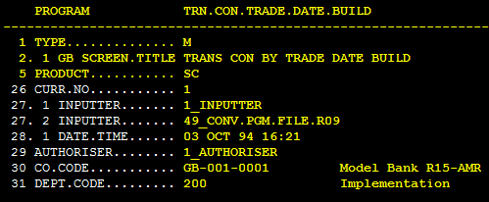
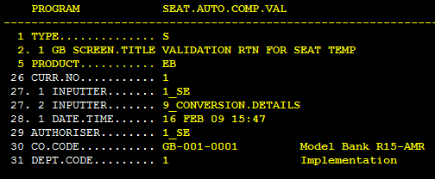
After compilation of Program/Subroutine
  After compiling the program/subroutine, create an entry in the PGM.FILE
  Program
  Subroutine
Subroutine

Slide 19
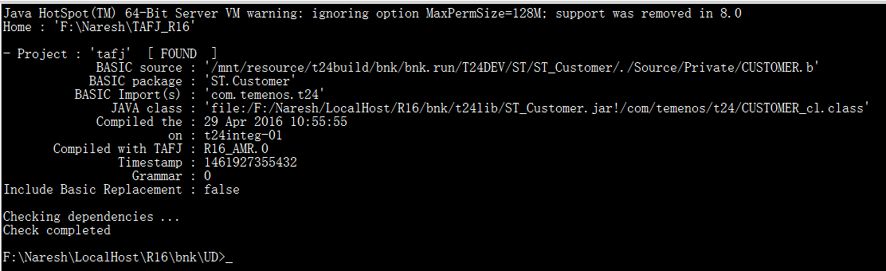
tShow Command
tShow used to:
  identify where programs are pointed and compiled to
    tShow –cf propertiesfile program_name
    tShow –cf tafj CUSTOMER

Slide 20
Exercise – Write a simple Infobasic Program
Exercise 1
  Write a program HELLO.WORLD to print “HELLO WORLD” and
  store the program in the directory TEST.BP
Hint
  Use CRT to print the string.
Solution
  Write a program under TEST.BP TEST.PROGAM
  PROGRAM TEST.PROGAM
  CRT “HELLO WORLD"
  END

Slide 21
Compile and execute the Program
Compile
tCompile –cf tafj HELLO.WORLD
Execute the program
tRun –cf tafj HELLO.WORLD
Notes:
Type FI in JED Command prompt to save the program.
To compile the program type EB.COMPILE BP HELLO from jBase prompt
To see the output type HELLO from jBase prompt
Type FI in JED Command prompt to save the program.
To compile the program type EB.COMPILE XXX.BP TEST.SUB from jBase prompt

Slide 22
Debugging
  DEBUG statement is used to debug the code.
  PROGRAM TEST.PROGAM
  DEBUG
  CRT “HELLO WORLD"
  END

Slide 23
Subroutines with Parameters
Subroutines can take In Parameters and Return the values as well.
Subroutines can take in any number of parameters
Subroutines can return any number of values
When defining a subroutine, the parameters for that subroutine are defined
Example:
Step 1:
Create a routine that accepts two values and returns the multiplication of two values in variable.
SUBROUTINE TEST.CALLED.RTN(A,B,C)
C = A * B
RETURN
END

Slide 24
Subroutines with Parameters – Contd…
Step 2: Create another routine that supplies the two values and prints the result.
PROGRAM TEST.CALLING.RTN
A = 10 ; B =20
CALL TEST.CALLED.RTN(A,B,RESULT)
PRINT “RESULT : ”:RESULT
END
Step 3: Compile and catalog the Program and Subroutine.
Step 4: Run the Program
Result : RESULT : 200

Slide 25
Control Structures
The various Control structures are
  IF-THEN-ELSE Structure
  CASE Structure
  FOR-NEXT Structure
  LOOP-REPEAT Structure

Slide 26
Control Structures
The IF clause is used to decide the flow to be executed depending on either the true or false of the statement. If the statement evaluates to a ‘true’ then the statements following the THEN clause will get executed. If the statement evaluates to a ‘false’ then the set of statements following the ‘ELSE’ clause would get executed. In most cases, either the THEN or the ELSE must be specified. In certain specific cases the ELSE clause only is available.
If the THEN or ELSE clause contains more than one statement, or you wish to place it on a separate line, you must use the multiline format that encloses the statements and terminates them with an END.

Slide 27
Control Structures
Syntax
IF Condition(s) THEN
Instruction1
Instruction2
...
END ELSE
Instruction1
Instruction2
...
END
Example
IF VALUE = “TRUE” THEN
PRINT “Value is True”
END ELSE
PRINT “Value is False”
END
Block True
Block False

Slide 28
IF THEN ELSE - EXAMPLE
A = 2
IF A > 10 THEN
PRINT “GIVEN NUMBER IS GT 10”
END ELSE
IF A> 5 THEN
PRINT “INPUT IS GT THAN 5 AND LE 10”
END ELSE
PRINT “INPUT GIVEN IS LT 5”
END
END
RESULT : INPUT GIVEN IS LT 5

Slide 29
Control Structures cont’d
Use the CASE statement to alter the sequence of instruction execution based on the value of one or more expressions.
If expression in the first CASE statement is true, the following statements up to the next CASE statement are executed.
Execution continues with the statement following the END CASE statement.
If the expression in a CASE statement is false, execution continues by checking the expression in the next CASE statement.
If it is true, the statements following the CASE statement up to the next CASE or END CASE statement are executed. Execution continues with the statement following the END CASE statement.
If more than one CASE statement contains a true expression, only the statements following the first such CASE statement are executed.
If no CASE statements are true, none of the statements between the BEGIN CASE and END CASE statements are executed.
Notes:
Expressions/statements evaluated in sequential order.
• when a true expression is encountered, the corresponding statements are executed and control exits from the CASE structure.
• when no true expression is encountered, then the statements under CASE 1 are executed and control exits from the CASE structure.
• when no true expression is encountered, and in the absence of CASE 1 expression, then no statements are executed and control exits from the CASE structure.
CASE Structure - Skeleton
BEGIN CASE
CASE relation expression I
set of statements
CASE relation expression II
set of statements
CASE 1
set of statements
END CASE

Slide 30
Control Structures cont’d
Syntax Example
BEGIN CASE APPL.NAME = APPLICATION
CASE condition BEGIN CASE
instruction CASE APPL.NAME = “CUSTOMER”
instruction PRODUCT= “ST”
CASE condition CASE USERNAME = “ACOUNT”
instruction PRODUCT = “AC”
instruction CASE 1 (or OTHERWISE)
CASE 1 (or OTHERWISE) PRODUCT = “”
another case END CASE
END CASE Note
APPLICATION is a common variable.

Slide 31
Control Structures cont’d
For Loop
  Use the For Loop to execute a set of statements repeatedly for specific number of times. The counted loop uses a variable to hold the iteration count. The loop is automatically incremented by a step value for each iteration. Once it has passed the end value, the loop terminates.
  Facilitates repeated execution of a set of statements.
  Control exits from structure after pre-determined number of executions.
Syntax
FOR <variable> = <initial value> TO <maximum value>
<statements>
NEXT <variable name> Example:
  FOR I = 1 TO 5
  CRT “Value of the I ”: I
  NEXT COUNTER
Notes:
FOR - NEXT Structure
Facilitates repeated execution of a set of statements.
Control exits from structure after pre-determined number of executions.
FOR - NEXT Structure- Example
FOR I = 1 TO 10
PRINT ‘Counter Variable:’: I
NEXT
I is the counter variable.
The PRINT statement executes for a pre-determined 10 times (i.e) till the value of I is 10

Slide 32
Control Structures cont’d
FOR - NEXT Structure- Example
FOR I = 1 TO 10
PRINT ‘Counter Variable:’: I
NEXT
I is the counter variable.
The PRINT statement executes for a pre-determined 10 times (i.e) till the value of I is 10
Notes:
FOR - NEXT Structure
Facilitates repeated execution of a set of statements.
Control exits from structure after pre-determined number of executions.
FOR - NEXT Structure- Example
FOR I = 1 TO 10
PRINT ‘Counter Variable:’: I
NEXT
I is the counter variable.
The PRINT statement executes for a pre-determined 10 times (i.e) till the value of I is 10

Slide 33
Control Structures cont’d
Output:
COUNTER VARIABLE:1
COUNTER VARIABLE:2
COUNTER VARIABLE:3
COUNTER VARIABLE:4
COUNTER VARIABLE:5
COUNTER VARIABLE:6
COUNTER VARIABLE:7
COUNTER VARIABLE:8
COUNTER VARIABLE:9
COUNTER VARIABLE:10

Slide 34
Control Structures cont’d
Open Loop
  The open loop specifies a more powerful loop construction that will continue to iterate until a condition is met to terminate the loop. The condition is held in the WHILE clause. The REPEAT statement takes the control back to the first line after the LOOP statement.
  Facilitates repeated execution of a set of statements. Control exits from structure when WHILE expression evaluates to false or UNTIL expression evaluates to true.
Syntax Example
LOOP LOOP
instruction CRT “Input Values”
instruction INPUT VAL1
{WHILE| UNTIL} cond WHILE VAL1
instruction CRT “Value “ : VAL1
instruction REPEAT
instruction
...
REPEAT
One can leave the loop by:
EXIT to leave
CONTINUE to pass an iteration

Slide 35
Control Structures cont’d
LOOP – REPEAT – Example
PROGRAM TEST2 Output:
X=0 X= 0
LOOP X= 1
UNTIL X>4 DO X= 2
PRINT "X= “ :X X= 3 X=X+1 X= 4
REPEAT
END

Slide 36
Other Flow Control Statements
EXIT - exit from loop structure prematurely.
END - mandatory last statement in a program. Signifies end of program.
STOP - terminates execution of program and the control transfers back to the process that invoked the program.
CALL - executes an external subroutine.
EXECUTE - executes Unix / jBase commands.
GOSUB - transfer the control of the program to an internal subroutine available within the program.
RETURN - used in conjunction with GOSUB. Transfers the control from the subroutine back to the next statement after GOSUB in the main program.
GOTO - transfers control of the program to a statement within the program. The control does not transfer back even when a return statement is encountered.

Slide 37
Functions
Following are the commonly used Basic functions.
General syntax is: Name_Function((arg1(,arg2….)))
Some Examples:
FIELD (var,separator, occur) extraction of string on a precise occurrence
STR generation of string
LEN(Var String) length of the string
CHAR(num) character corresponding to the code
TRIM(Var String) eliminate redundant spaces ;
ex: VAR="A B"
CRT TRIM(VAR) give A B
COUNT count the substring repeated in a string.
DCOUNT return number of delimited fields in a data string.
UPCASE(string) a string puts in upper case/capital letters
DOWNCASE(string) a string puts in lower case/small letters
OCONV(Var, "code") convert string to a specified format for external output
ICONV(Var, "code") convert string to a specified format for internal
CHANGE(String,var,var1) change the var to var1

Slide 38
Expressions
An expression is a composition of data items :
ARITHMATIC:
+ addition
- subractraction
* multiplication
/ division
** or ^ power
LOGIC:
AND and logic
OR or logic
NOT negation
Expression := [constant|variable|function] operator ….
Notes:
Logical Operators:
They are operators that combine two or more relational expressions. Logical operators in Infobasic are
AND
OR
NOT
Example
IF EMP.DESG EQ ‘MGR’ AND EMP.SAL GT 10000 THEN In the logical expression above, the logical operator ‘AND’ combines the two relational expressions ‘EQ’ and ‘GT’.

Slide 39
Expressions
RELATIONAL OPERATORS :
= or EQ equal
> or GT greater than
>= or GE greater than or equal
< or LT less than
<= or LE less than or equal
# or NE different
CONCATENATION :
: or CAT concatenation of strings
[pos,nbr] extraction
[sep , occ , nb] extraction of groups

Slide 40
INPUT
To Accept a Value for a Variable From User
SYNTAX :
INPUT VARIABLE, LENGTH
EXAMPLE
INPUT NAME,10
In this Example The User is Restricted to enter 10 characters only.
INPUT @(10,5):N,10
INPUT @(COL,ROW):Variable, len

Slide 41
DISPLAY
CRT
Used to place Text & Data on the terminal
SYNTAX :
CRT @(COLUMN,ROW): TEXT / VARIABLE
Example :
CRT A,B,C
CRT @(10,5): “AMERICAN EXPRESS BANK”

Slide 42
PRINT
This statement is used to print the value of a variable or text. Can be used in conjunction with INPUT statement to prompt the user for input.
SYNTAX :
PRINT @(COLUMN,ROW): TEXT / VARIABLE
Example :
PRINT @(10,12):A,B
PRINT @(10,12): “ENTER THE NAME”:
INPUT NAME,12

Slide 43
FIELD, STR and LEN
FIELD
  Extraction of string on a precise occurrence
  Syntax
  FIELD (variable,separator, occurrance)
Example
  Val = “10”:FM:”20”:FM:”30”
  Ext = FIELD (Val,FM,2)
  CRT Ext will contain 20

Slide 44
FIELS, STR and LEN
STR
  Generation of strings
  Syntax
  STR(string,number)
  Example
  VAL = STR(“TEST”,3)
  VAL will contain TESTTESTTEST
LEN
  Length of string
  Syntax
  LEN (Var string)
  Example
  Var = LEN(“TEST”)
  Var will contain 4

Slide 45
CHAR and TRIM
CHAR
  character corresponding to the code
  Syntax
  CHAR (number)
  Example: VAL = CHAR(217)
  VAL will contain “Y”
TRIM
  eliminate redundant spaces
  Syntax
  TRIM (string)
  Example: Var = TRIM(“TEST”)
  Var will contain TEST
  TRIMF - Removes leading spaces from a string.
  TRIMB - Removes trailing spaces from a string.

Slide 46
INDEX
  Returns the starting column position of a specific occurrence of a specified sub string within a character string.
Syntax:
INDEX(string,sub string,occur)
Example :
A = “AMERICAN EXPRESS BANK”
B = INDEX(A,”AN”,2)
B returns the value 19
It displays the position of the 2nd occurrence the string “AN” within the string A

Slide 47
COUNT and DCOUNT
COUNT
  The number of times a substring is repeated in a string value.
  Syntax
  COUNT (string,occurrence)
Example: REC=34:@VM:55:@VM:88
R=COUNT(REC,@VM)
Result : R has a Value of 2.
DCOUNT
  return the number of delimited fields in a string
  Syntax
  DCOUNT (string,occurrence)
Example: REC=34:@VM:55:@VM:88
R=DCOUNT(REC,@VM)
Result : R has a Value of 3.

Slide 48
UPCASE, DOWNCASE, OCONV
UPCASE
  Converts the string to the upper-case letters
DOWNCASE
  Converts the string to the lower-case letters
OCONV
  Converts string to a specified format for external output.
  SYNTAX:
  OCONV(string,conversion code)
  Example
  VAR = OCONV(‘12000',"D2“)
  Var will contain 07 NOV 00

Slide 49
ICONV
ICONV
  Converts string to a specified format for internal use.
  SYNTAX:
  ICONV(string,conversion code)
  Example
InternalDate = ICONV("27 MAY 1997", "D")
In this example ICONV returns the internal form of the date May 27, 1997.

Slide 50
CHANGE
CHANGE
  function to replace a substring in expression with another substring. If you do not specify occurrence, each occurrence of the substring will be replaced.
  Syntax
  CHANGE string_1 to string_2 IN VAR
  Example
  Var1= CHANGE(“SAMPLE”,”A”,”I”)
  Var1 is now SIMPLE

Slide 51
CONVERT and EXECUTE
CONVERT
  command to convert characters to other characters.
  Syntax
  CONVERT char_Expr1 TO char_Exp2 IN Var
  Example
  Y.STRING = “TEMENOSFMT24”
  CONVERT FM TO VM IN Y.STRING
  CRT Y.STRING
  TEMENOSVMT24
EXECUTE
  command to run the TCL command and to return in the program.
  Example
  EXECUTE “SELECT FBNK.CUSTMER”

Slide 52
Sequential Files Cont’d
OPENSEQ
  used to open a file.
  While using OPENSEQ to open file, the record id needs to be supplied as one of the parameters. OPENSEQ will open that record to a pointer.
Syntax
  OPENSEQ filename,recordid to pointer
OPENSEQ “ SAMPLE.TXT “ TO FICSEQ THEN
PRINT ” Correct opening ”
END ELSE
CREATE FICSEQ ELSE STOP
END

Slide 53
Sequential Files Cont’d
READSEQ
  the command used to read data from a sequential file.
Syntax
  READSEQ variablename FROM filepointer THEN …… ELSE…..
  Variablename : Name of the variable that will hold the data that has been retrieved from the file.
  THEN : The THEN clause will be met when the read operation is successful.
  ELSE : The ELSE clause would be met when the read operation is unsuccessful. It would fail if the file pointer is not initialized properly.

Slide 54
Sequential Files Cont’d
WRITESEQ
  the command used to write data onto a non-hashed or sequential file.
Syntax
  WRITESEQ Message TO FilePointer ELSE ErrorMessage
  If the filepointer doesn’t exist then the else ErrorMessage is triggered.
CLOSESEQ
  the command used to close a sequential file after all read & write operations for that file are complete.
Syntax
  CLOSESEQ FilePointer

Slide 55
LOCATE
LOCATE statement
  to locate the position of a string or
  to determine the position to insert into a specific sequence.
Example :
Y.ARRAY = 'KALLIS':@FM:'JONTY':@VM:'NICKY‘
LOCATE ‘KALLIS’ IN Y.ARRAY<2,1> SETTING POS ELSE NULL
RESULT: 2
LOCATE expression IN
dynamic.array <FIELD,VALUE,STARTPOS> SETTING Variable
[ THEN statements [ ELSE statements ] ]

Slide 56
Example to Demonstrate the Locate Command:
PROGRAM LOC.PGM
Y.UD.MOD.LIST = "AC" : @VM : "FX" : @VM : "LD"
PRINT "INPUT MOD"
INPUT Y.UD.MOD
Y.UD.MOD.LOC.POS = ""
LOCATE Y.UD.MOD IN Y.UD.MOD.LIST<1,1> SETTING Y.UD.MOD.LOC.POS THEN
PRINT Y.UD.MOD.LOC.POS
PRINT "AC IS FOUND"
END ELSE
PRINT " NO AC"
END
STOP

Slide 57
FIND
Find Searches the entire string in a dynamic array.
Finds the location of a specified string within a Dynamic array.
Syntax :
FIND <string> IN <array> SETTING var1,var2,var3 THEN/ELSE <statements>
Example :
ARRAY = ‘ABCD’:@FM:’1000’:@VM:’2000’
FIND ‘2000’ IN ARRAY SETTING Y.POS1,Y.POS2,Y.POS3 ELSE NULL
PRINT Y.POS1:’,’:Y.POS2:’,’:Y.POS3
Result:
2,2,1

Slide 58
FINDSTR
FindSTR searches the string which can be either a string or a Substring in a dynamic array.
Syntax :
FINDSTR <string> IN <array> SETTING var1,var2,var3 THEN/ELSE <statements>
Example :
ARRAY = ‘KALLIS’:@FM:’JONTY’:@VM:’NICKY’
FINDSTR ‘ONT’ IN ARRAY SETTING Y.POS1,Y.POS2,Y.POS3 ELSE NULL
PRINT Y.POS1:’,’:Y.POS2:’,’:Y.POS3
RESULT: 2,1,1

Slide 59
DEL and INS
DEL
Deletes the data contents of a field, value or subvalue in a dynamic array.
Syntax:
  DEL Array<field, val, sval>
  Example:
DEL TESTREC<0,0,0>
INS
Insert new value before a specified field, value or subvalue in a Dynamic Array.
Syntax:
  INS Expression BEFORE Array<field, val, sval>
  Example :
INS xxx BEFORE TESTREC<0,0,0>

Slide 60
Example to Demonstrate INS and DEL
PROGRAM INS.PGM
Y.ARRAY = "MUTHU":@FM:'KALLIS':@VM:"STENI":@SM:"PREETHI":@FM:'JONTY':@VM:'NICKY’ :@SM:"VIJAY"
PRINT "Y.ARRAY IS " :Y.ARRAY
DEL Y.ARRAY<1,1,1>
PRINT "AFTER DELETING Y.ARRAY<1,1,1> THE ARRAY IS ":Y.ARRAY
INS "ANANDHI" BEFORE Y.ARRAY<2,2,1>
PRINT "AFTER INSERTING BEFORE Y.ARRAY<2,2,1> THE ARRAY IS":Y.ARRAY
END

Slide 61
INS and DEL - Output
Output:
Y.ARRAY IS MUTHUÒKALLISySTENIüPREETHIÒJONTYyNICKYüVIJAY
AFTER DELETING Y.ARRAY<1,1,1> THE ARRAY IS ÒKALLISySTENIüPREETHIÒJONTYyNICKYüVIJAY
AFTER INSERTING BEFORE Y.ARRAY<2,2,1> THE ARRAY IS ÒKALLISyANANDHIüSTENIüPREETHIÒJONTYyNICKYüVIJAY

Slide 62
OPF
Used to open a File for reading or writing purposes.
It has two parameters passed.
SYNTAX :
CALL OPF(File name,File pointer)
Filename : Name of the File (Example : ‘FBNK.CUSTOMER’)
File pointer : Path of the file
Example :
FN.CUSTOMER = ‘FBNK.CUSTOMER’
F.CUSTOMER = ‘’
CALL OPF(FN.CUSTOMER,F.CUSTOMER)
NOTE:
File pointer is initialized with null value and at the time of execution it will be assigned to the path of the file.

Slide 63
F.READ
Used to read a record from a file which is already opened using OPF.
F.READ has five parameters.
Syntax
  F.READ(<filename>,<id of record>,<dynamic array that contains the record that is read>,<file path>,<error variable>)
Example
  Y.CUSID = “100069”
  CALL F.READ(FN.CUS,Y.CUSID,R.CUSTOMER,F.CUS,CUS.ERR)
Note
  R.CUSTOMER is a dynamic array that will hold the extracted customer record. It does not require declaration, but initializing it to a ‘’ would be a good programming practice.
  The error variable CUS.ERR1 will hold ‘null’ if the read is successful
  or else will hold a numeric value.
  Note that the id of the record has been supplied using a variable.

Slide 64
F.READV
To read only one field of the record use the T24 subroutine F.READV.
Syntax
  F.READV(<filename>,<id of record>,<variable>,<field>,<file path>,<error variable>)
Example
  Y.CUSID = “######”
  CALL F.READV(FN.CUS,Y.CUSID,R.CUSTOMER,F.CUS,CUS.ERR)

Slide 65
F.READU
to read the record from the ACCOUNT file. Normally, you’d use the F.READ statement for reading a record from a file without locking it.
to lock the record while keeping exclusive control over it, use F.READU instead of F.READ.
Parameters:
  FILEID file name
  KEY record-id
  REC record returned
  F.FILEID file variable
  ER returning error message
  RETRY P R I E “”
  CALL F.READU(FN.ACC,Y.AC.ID,R.ACCOUNT,F.ACC,Y.ACC.ERR,RETRY)
to modify a record, use F.READU and get the record.

Slide 66
Example of OPF and READ
FN.CUSTOMER = ‘FBNK.CUSTOMER’
F.CUSTOMER = ‘’
R.CUSTOMER = ‘’
CALL OPF(FN.CUSTOMER,F.CUSTOMER)
CALL F.READ(FN.CUSTOMER,Y.CUSTOMER.ID,R.CUSTOMER, F.CUSTOMER,Y.CUS.ERR)

Slide 67
F.WRITE
F.WRITE is a core T24 subroutine used to write a record onto a file.
  The routine works differently depending on the mode of T24.
  If the system is in Online mode, then F.WRITE will only write the data onto the cache.
  If the system is in Batch mode (COB in progress) then it will write straight to the disk and not to the cache provided the F.WRITE is not within a trans-action block.
Syntax
  F.WRITE(<filename>,<id of record>,<record>)
Example
  CALL F.WRITE(FN.ACC,Y.AC.ID,R.ACCOUNT)

Slide 68
Example of F.WRITE
<Initialize variables FN.CUSTOMER,F.CUSTOMER,….>
<Open the file using OPF>
<Read the record using F.READ>
<Assign the value to the dynamic array which we are going to write>
FN.CUSTOMER = ‘F.CUSTOMER’
F.CUSTOMER = ‘’
CALL OPF(FN.CUSTOMER,F.CUSTOMER)
CUS.ID = ‘100285’
CALL F.READ(FN.CUSTOMER,CUS.ID,R.CUSTOMER,F.CUSTOMER,CUS.ERR)
R.CUSTOMER<EB.CUS.SHORT.NAME> = ‘ABC CORPORATION’
CALL F.WRITE (FN.CUSTOMER,Y.CUSTOMER.ID,R.CUSTOMER)

Slide 69
Workshop
Write a subroutine that will display the details (Id, Mnemonic
and Nationality) of a customer whose id is 100037

Slide 70
Workshop - Algorithm
Algorithm:
Step 1. Open the customer file
Step 2. Read the customer file and extract the record with id 100037
Step 3. From the extracted record obtain the mnemonic and nationality
Step 4. Display the customer id, mnemonic and nationality

Slide 71
Workshop - Solution
SUBROUTINE CUST.READ
$INSERT I_COMMON
$INSERT I_EQUATE
$INSERT I_F.CUSTOMER
GOSUB INIT
GOSUB OPENFILES
GOSUB PROCESS
RETURN
INIT:
FN.CUS = "FBNK.CUSTOMER"
F.CUS = " "
Y.CUS.ID = '100037'
Y.NATIONALITY = " "
Y.MNEMONIC = " "
R.CUSTOMER = " "
Y.ERR = " "
RETURN

Slide 72
Workshop - Solution – Contd…
OPENFILES:
CALL OPF(FN.CUS,F.CUS)
RETURN
PROCESS:
CALL F.READ(FN.CUS, Y.CUS.ID , R.CUSTOMER , F.CUS, Y.ERR)
Y.NATIONALITY = R.CUSTOMER<EB.CUS.NATIONALITY>
Y.MNEMONIC = R.CUSTOMER<EB.CUS.MNEMONIC>
PRINT “CUSTOMER ID IS :”:Y.CUS.ID
PRINT "NATIONALITY IS :":Y.NATIONALITY
PRINT "MNENOMIC IS :":Y.MNEMONIC
RETURN
END

Slide 73
Workshop
Write a subroutine that will display the details (Id, Mnemonic
and Nationality) of all customers

Slide 74
Workshop - Algorithm
Algorithm:
Step 1. Open the Customer File
Step 2. Select all the customer ids
Step 3. Remove one customer id from the selected list
Step 4. For the extracted customer id extract the corresponding record from the customer file
Step 5. From the extracted record extract the mnemonic and nationality
Step 6. Display the customer id, mnemonic and nationality Repeat Steps 3 to 6 for all customers

Slide 75
Workshop - Solution
*Subroutine to display the mnemonic and nationality of all customers
SUBROUTINE CUS.DISPLAY.DETAILS
$INSERT I_COMMON
$INSERT I_EQUATE
$INSERT I_F.CUSTOMER
GOSUB INIT
GOSUB OPENFILES
GOSUB PROCESS
RETURN
INIT:
FN.CUS = 'F.CUSTOMER'
F.CUS = ''
Y.CUS.ID = ''
R.CUSTOMER = '‘
CUS.ERR1 = ''

Slide 76
Workshop - Solution
Y.MNEMONIC = ''
Y.NATIONALITY = ''
SEL.CMD = ''
SEL.LIST = ''
NO.OF.REC = 0
RET.CODE = ''
RETURN
OPENFILES:
CALL OPF(FN.CUS,F.CUS)
RETURN
PROCESS:
SEL.CMD = "SELECT ":FN.CUS
CALL EB.READLIST(SEL.CMD,SEL.LIST,'',NO.OF.REC,RET.CODE)
LOOP
REMOVE Y.CUS.ID FROM SEL.LIST SETTING POS
WHILE Y.CUS.ID:POS
CALL F.READ(FN.CUS,Y.CUS.ID,R.CUSTOMER,F.CUS,CUS.ERR1)

Slide 77
Workshop - Solution
Y.MNEMONIC = R.CUSTOMER<EB.CUS.MNEMONIC>
Y.NATIONALITY = R.CUSTOMER<EB.CUS.NATIONALITY>
CRT "Customer Id: ":Y.CUS.ID
CRT "Customer Mnemonic: ":Y.MNEMONIC
CRT "Customer Nationality: ":Y.NATIONALITY
REPEAT
RETURN
END

Slide 78
Workshop
Write a subroutine that will display the details (Id, Mnemonic
and Nationality) in a dynamic array in the following format
CusId*Mnemonic*NationalityFMCusId*Mnemonic*Nationality

Slide 79
Workshop - Algorithm
Algorithm
Step 1. Open the Customer File
Step 2. Select all the customer ids
Step 3. Remove one customer id from the selected list
Step 4. For the extracted customer id extract the corresponding record from the customer file
Step 5. From the extracted record extract the mnemonic and nationality
Step 6. Store the customer id, mnemonic and the nationality in a dynamic array
Repeat Steps 3 to 6 for all customers

Slide 80
Append Data in An Array
ARRAY<-1> = NewValue
ARRAY<-1> = Y.CUS.ID:’*’:Y.MNEMONIC:’*’:Y.NATIONALITY
What if an array delimited with VM’s need to formed?
ARRAY<1,-1> = Value
What if an array delimited with SM’s need to be formed?
ARRAY<1,1,-1> = Value

Slide 81
Workshop - Solution
*Subroutine to store the id, mnemonic and nationality of all *customers in an array
SUBROUTINE CUS.DISPLAY.DETAILS
$INSERT I_COMMON
$INSERT I_EQUATE
$INSERT I_F.CUSTOMER
GOSUB INIT
GOSUB OPENFILES
GOSUB PROCESS
RETURN
INIT:
FN.CUS = 'F.CUSTOMER'
F.CUS = ''
Y.CUS.ID = '‘
R.CUSTOMER = ''

Slide 82
Workshop - Solution
CUS.ERR1 = ''
Y.MNEMONIC = ''
Y.NATIONALITY = ''
SEL.CMD = ''
SEL.LIST = ''
NO.OF.REC = 0
RET.CODE = ''
CUS.DETAILS.ARRAY = ''
RETURN
OPENFILES:
CALL OPF(FN.CUS,F.CUS)
RETURN
PROCESS:
SEL.CMD = "SELECT ":FN.CUS
CALL EB.READLIST(SEL.CMD,SEL.LIST,'',NO.OF.REC,RET.CODE)
LOOP
REMOVE Y.CUS.ID FROM SEL.LIST SETTING POS
WHILE Y.CUS.ID:POS
CALL F.READ(FN.CUS,Y.CUS.ID,R.CUSTOMER,F.CUS,CUS.ERR1)

Slide 83
Workshop - Solution
Y.MNEMONIC = R.CUSTOMER<EB.CUS.MNEMONIC>
Y.NATIONALITY = R.CUSTOMER<EB.CUS.NATIONALITY>
CUS.DETAILS.ARRAY<-1> =
Y.CUS.ID:'*':Y.MNEMONIC:'*':Y.NATIONALITY
REPEAT
RETURN
END

Slide 84
CACHE.READ
CACHE.READ is a routine used to read a record from a file.
It checks whether the record exists in cache.
If so, it checks if it is not older than the number of seconds specified in the field CACHE.EXPIRY in SPF.
If not, it extracts the record.
Otherwise T24 will perform an OPF and F.READ to extract the record.
Opening the file is not required.
Faster than F.READ.
Should be used for extracting records that are not frequently updated.
Best used for extracting parameter records.
Syntax
  CACHE.READ(FileNameWithoutMne,ID,Record,Error variable)

Slide 85
CACHE.READ
CACHE.READ
If you wish to read and cache records of some static or parameter applications such as SECTOR, CATEGORY etc.. we must use CACHE.READ
Use this routine to read data from applications that contain frequently used but static data
Never use this to read financial data (Ex: ACCOUNT)
Example:

Slide 86
CACHE.READ – Sample Routine
SUBROUTINE TRG.TEST1
$INSERT I_COMMON
$INSERT I_EQUATE
$INSERT I_F.SECTOR
FN.SEC='F.SECTOR'
F.SEC=''
Y.SEC.ID='1001'
R.SEC1=''
R.SEC2=''
Y.SEC.ERR=''
CALL OPF(FN.SEC,F.SEC)
CALL CACHE.READ(FN.SEC,'1001',R.SEC2,Y.SEC.ERR)
CRT "CACHE.READ OUTPUT"
CRT R.SEC2
RETURN
END

Slide 87
DBR
DBR is used to extract value from a single field from a record.
It reads the record, fetches the required field’s value and returns to
the calling program.
DBR doesn’t expect the file to be opened, as DBR opens the file internally.
Syntax
  CALL DBR(<FileName:FM:Fldname:FM:”LangFld”>,<ID>,<RetVar>)
  CALL DBR(“ACCOUNT”:FM:AC.CUSTOMER,123456,Y.RET.VAL)
Parameters
  Field 1 = File Name (without 'F.')
  Field 2 = Name of the field as in the insert file whose value needs to be fetched
  Field 3 = miscellaneous arguments (delimiter = '.‘)
Out Parameters
Value of the field that has been fetched.

Slide 88
REMOVE
REMOVE is the Function that is used to extract a value from a dynamic array.
Syntax:
REMOVE <var> FROM <array> SETTING <set var>
Var : variable which holds the extracted string
Array : Dynamic array from which the string is to be extracted.
Set var : Delimiter by which string is extracted from array.
(2 – FM, 3 – VM, 4 – SM, 0 – End of array)

Slide 89
EB.READLIST
Used to execute a Select statement within a subroutine
Syntax
CALL EB.READLIST(Selectcommand,Selectedlist,’’,NoOfRecordsSelected, ReturnCode)
  1. The select statement to be executed. Give the name of the variable that holds the select statement here.
  2. The name of a dynamic array that will hold the result of the select statement. Please note that a select statement here can only select ids from the respective file. Therefore this dynamic array will only hold the ids of the records that have been selected. All the ids are delimited by a field marker (FM).
  3. This is an optional parameter. Usually this is set to NULL (‘’)
  4. A variable that will hold the number of records selected.
  Note the space. If this space is not given then SEL.CMD will contain “SELECTFBNK.CUSTOMER” thus resulting in an error in EB.READLIST
  5. A variable to hold the return code. Will contain null if the select statement was successful else will contain 1 or 2.
Notes:
The API EB.READLIST can be used to select records from file. This API was used in earlier releases of T24. It is advised to use DAS (Data Access service) for selecting records. DAS will be dealt in detail in Template programming course.
SSELECT command can be used instead of SELECT, if we want the selected ids in sorted order. The select command can be suffixed with “BY DSND” if records have to be sorted in descending order.

Slide 90
EB.READLIST – Contd…
Example:
<Initialize File name FN.CUSTOMER>
  FN.CUSTOMER = ‘F.CUS’
  F.CUSTOMER = ‘’
  CALL OPF(FN.CUSTOMER,F.CUSTOMER)
  SEL.CMD = “SELECT “:FN.CUS
  CALL EB.READLIST(SEL.CMD,SEL.LIST,’’,NO.OF.REC,CUS.ERR)
Note the space
You may use SSELECT instead of SELECT if you want data in sorted order

Slide 91
Subroutine with EB.READLIST incorporated
SUBROUTINE TRG.TEST1
$INSERT I_COMMON
$INSERT I_EQUATE
$INSERT I_F.ACCOUNT
GOSUB INIT
GOSUB OPENFILES
GOSUB PROCESS
RETURN
INIT:
FN.ACC='F.ACCOUNT‘;F.ACC='‘;Y.ACC.ID=13935;R.ACC='‘;Y.ACC.ERR=''
RETURN
OPENFILES:
CALL OPF(FN.ACC,F.ACC)
RETURN
PROCESS:
SEL.CMD="SELECT ":FN.ACC
CALL EB.READLIST(SEL.CMD,SEL.LIST,'',NO.OF.REC,RET.CODE)
LOOP
REMOVE Y.ACC.ID FROM SEL.LIST SETTING POS
WHILE Y.ACC.ID:POS
CALL F.READU(FN.ACC,Y.ACC.ID,R.ACC,F.ACC,Y.ACC.ERR,'')
CRT"ID-":Y.ACC.ID :"CATEGORY-":R.ACC<AC.CATEGORY>:"CURRENCY":R.ACC<AC.CURRENCY>
REPEAT
RETURN
END

Slide 92
Workshop
Write a subroutine that will changes the Account officer from 1 to 2 and display the details (Customer, Mnemonic, Old Acct officer and New Acct officer) for all customers.

Slide 93
Workshop - Algorithm
Algorithm:
Step 1 : Select all the customer records
Step 2 : Open the customer file
Step 3 : Read the Customer records one by one
Step 4 : Check the existing Account.Officer value and if it is ‘1’ then assign the new value of Account Officer to ‘2’
Step 5 : Extract the required details to be printed from the record
Step 6 : Display the details

Slide 94
Workshop - Solution
SUBROUTINE CUST.READ.WRITE
$INSERT I_COMMON
$INSERT I_EQUATE
$INSERT I_F.CUSTOMER
GOSUB INIT
GOSUB OPENFILES
GOSUB PROCESS
RETURN
INIT:
FN.CUS = "FBNK.CUSTOMER"
F.CUS = " "
Y.CUS.ID = ‘’
Y.NATIONALITY = " "
Y.MNEMONIC = " "
R.CUSTOMER = " "
Y.ERR = " "
RETURN

Slide 95
Workshop – Solution – Contd…
OPENFILES:
CALL OPF(FN.CUS,F.CUS)
RETURN
PROCESS:
SEL.CMD = ‘SELECT “:FN.CUS
CALL EB.READLIST(SEL.CMD,SEL.LIST,’’,NO.OF.REC,RET.CODE)
LOOP
REMOVE Y.CUS.ID FROM SEL.LIST SETTING POS
WHILE Y.CUS.ID:POS
CALL F.READ(FN.CUS, Y.CUS.ID , R.CUSTOMER , F.CUS , Y.ERR)
Y.OLD.ACCT.OFFICER = R.CUSTOMER<EB.CUS.ACCOUNT.OFFICER>
IF Y.OLD.ACCT.OFFICER EQ ‘1’ THEN
Y.NEW.ACCT.OFFICER = ‘2’
R.CUSTOMER<EB.CUS.ACCOUNT.OFFICER> = Y.NEW.ACCT.OFFICER
END

Slide 96
Workshop – Solution – Contd…
Y.DET = Y.CUS.ID:’ * ‘:Y.MNEMONIC:’ * ‘:Y.OLD.ACCT.OFFICER:’ * ‘: Y.NEW.ACCT.OFFICER
Y.NEW.ACCT.OFFICER = ‘’
PRINT Y.DET
REPEAT
RETURN
END

Slide 97
F.DELETE
F.DELETE is also a core T24 subroutine that is used to delete a record from a file.
Syntax
  F.DELETE(FileName,Id of the record to be deleted)
Example
  CALL F.DELETE(FN.CUS,Y.CUSID)

Slide 98
JOURNAL.UPDATE
JOURNAL.UPDATE is a core routine that updates the F.JOURNAL when a transaction happens.
When the system is in Online mode and if we are using F.WRITE, then it will write the data on to the cache and not to the disk. So a Call to JOURNAL.UPDATE is required after a Write Statement.
When the system is in Batch mode, system takes care of writing on to the disk. Hence call to JOURNAL.UPDATE is not required.

Slide 99
Other Core Routines
STORE.END.ERROR
  to store error messages by field, to be displayed at the end of validation processing. The Error Message that is displayed is the one that is in the Variable ETEXT
  AF stores the field value
  AV stores the multi-value
  AS stores the sub-value
  Assign the field, multi-value and sub-value as per the requirement to display error message alongside the field no.
  Example:
  ETEXT = "Les parts G ne sont pas remboursables"
  AF = SC.PST.SECURITY.CODE
  CALL STORE.END.ERROR

Slide 100
STORE.OVERRIDE
Description : This routine is used to prompt for an override and store the message in the main file record if the user replies ‘Y’.
Arguments:
(CURR.NO)
AF, AV, AS and TEXT → from I_COMMON
Incoming:
CURR.NO -> Current record number
AF -> Field number to return to if user replies 'NO‘
AV -> Value number to return to if user replies 'NO'
AS -> Sub-Value to return to if user replies 'NO' TEXT Override message
Returned:
TEXT -> User's reply, 'Y' or 'NO'

Slide 101
GET.STANDARD.SELECTION.DETS
Description : This routine is used to read the standard selection record and merges the SYS and USR fields. This routine contains a dimensioned cache of the standard selection record T.SS.REC and dynamic list of standard selection ids T.SS.IDs.
Arguments:
STANDARD.SEL.ID, SS.REC
Incoming:
STANDARD.SEL.ID -> Key to STANDARD.SELECTION record
Returned:
SS.REC -> STANDARD.SELECTION record with USR and SYS fields merged into the SYS fields.

Slide 102
GET.STANDARD.SELECTION.DETS
Examples:
SUBROUTINE STD.SEL.DETS.TEST
$INSERT I_COMMON
$INSERT I_EQUATE
STANDARD.SEL.ID = ‘TH.HO.CHQ.REG’
CALL GET.STANDARD.SELECTION.DETS(STANDARD.SEL.ID,SS.REC)
PRINT “RECORD IS :”: SS.REC
INPUT AA
END

Slide 103
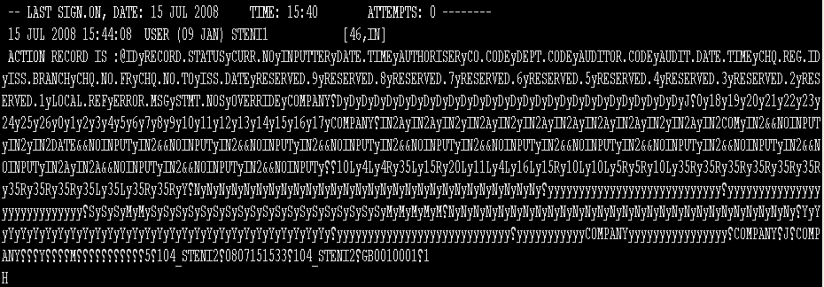
GET.STANDARD.SELECTION.DETS
Output:

Slide 104
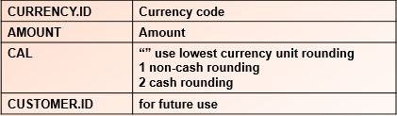
EB.ROUND.AMOUNT
Description : This routine is used to format the amount according to current definitions, by:
    Using defaults two decimal places
    Using defined number or decimal places for the currency
    Using the lowest unit of currency and rounding according to lowest unit.
Arguments:
CURRENCY.ID, AMOUNT, CAL, CUSTOMER.ID
Incoming:
Returned:
AMOUNT -> The amount rounded and formatted according to the currency and CAL specified

Slide 105
EB.ROUND.AMOUNT
Examples
SUBROUTINE ROUND.AMT
$INSERT I_COMMON
$INSERT I_EQUATE
CURRENCY.ID = ‘USD’
AMOUNT = 9997.5684
CAL = 2
CUSTOMER.ID = ‘’
CALL EB.ROUND.AMOUNT(CURRENCY.ID, AMOUNT, CAL , CUSTOMER.ID)
PRINT “THE ROUNDED AMOUNT IS :”: AMOUNT
INPUT AA
END

Slide 106

EB.ROUND.AMOUNT
Output:

Slide 107
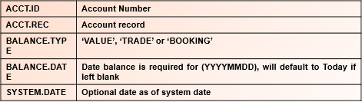
EB.GET.ACCT.BALANCE
Description: This routine is used to return an account balance of a given type on a given date, and to return the balance at a requested system date without adjustments. This routine obtains the balance by using the correct ACCT.ACTIVITY record for the requested date.
Arguments:
ACCT.ID, ACCT.REC, BALANCE.TYPE, BALANCE.DATE, SYSTEM.DATE, BALANCE, CREDIT.MVMT, CREDIT.MVMT, DEBIT.MVMT, ERR.MSG
Incoming:

Slide 108
EB.GET.ACCT.BALANCE
Returned:
BALANCE | Returned balance
CREDIT.MVMT | Returned net credit movement for the date
DEBIT.MVMT | Returned net debit movement for the date
ERR.MSG | Any error messages

Slide 109
EB.GET.ACCT.BALANCE
Examples:
SUBROUTINE GET.ACCT.BALANCE
$INSERT I_COMMON
$INSERT I_EQUATE
ACCT.ID = 11509
ACCT.REC = 11509
BALANCE.TYPE = ‘VALUE’
BALANCE.DATE = TODAY
SYSTE
CALL EB.GET.ACCT.BALANCE(ACCT.ID, ACCT.REC, BALANCE.TYPE, BALANCE.DATE, SYSTEM.DATE, BALANCE, CREDIT.MVMT, CREDIT.MVMT, DEBIT.MVMT, ERR.MSG)
PRINT “BALANCE IS “:BALANCE
PRINT “CREDIT MVMT IS “:CREDIT.MVMT
PRINT “DEBIT MVMT IS “:DEBIT.MVMT
PRINT “ERROR :”: ERR.MSG
INPUT AA
END

Slide 110
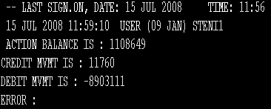
EB.GET.ACCT.BALANCE
Output:

Slide 111
CDD
Description : This routine is used to calculate the difference between two supplied dates, in days.
Arguments:
(REGION, DATE1, DATE2, DAYS)
Incoming:
REGION -> Region code, DATE1 -> Start date, in YYYYMMDD
DATE2 -> End date, in YYYYMMDD
DAYS -> 'W' to indicate working days, 'C' to indicate calendar days
Returned:
DAYS -> Difference in days. Either in + or -.

Slide 112

CDD
Example:
PROGRAM CDDEX.RTN
Y.REGION=""
Y.DATE1="20071101"
Y.DATE2="20081101"
Y.DAYS=“C"
CALL CDD(Y.REGION,Y.DATE1,Y.DATE2,Y.DAYS)
PRINT "THE DIFFERNCE BETWEEN “:Y.DATE1:” AND “ :Y.DATE2: “IN DAYS IS ":Y.DAYS
END
Output:

Slide 113
CDT
Description : This routine is used to calculate the forward or previous date from a start date using the number of days.
Arguments:
(REGION, DATE, DAYS)
Incoming:
REGION -> Region code, DATE -> Start date, YYYYMMDD
DAYS -> The number of days forward in the format + or -, the number of days, working or calendar e.g. +99C, -6W, +66W+3C
Returned:
DATE -> The calculated date
ETEXT -> Error message, if unsuccessful.

Slide 114

CDT
Example:
PROGRAM CDTEX.RTN
Y.REGION=""
Y.DATE1="20071101"
Y.DAYS=99
CALL CDT(Y.REGION,Y.DATE1,Y.DAYS)
PRINT "THE NO OF DAYS FORWRD BY 99 IS ":Y.DATE1
END
Output:

Slide 115
CFQ
Description : This routine is used to calculate the next date from today's date and a frequency code.
Arguments:
Nil
Incoming:
COMI YYYYMMDDXXXXX, where YYYYMMDD -> input date and XXXXX -> frequency code.
Returned:
COMI YYYYMMDDXXXXX i.e. the calculated date and the frequency code.

Slide 116

CFQ
Example:
SUBROUTINE CFQEX.RTN
$INSERT I_COMMON
$INSERT I_EQUATE
COMI = ‘20080711M0301’
CALL CFQ
PRINT “THE NO OF DAYS POSTPONED FROM THE INPUT DATE IS “: COMI
INPUT AA
END
Output:

Slide 117
JULDATE
Description : This routine is used to convert from Julian to Gregorian date format and vice versa.
Arguments:
GREGORIAN.DATE,JULIAN.DATE
Incoming:
GREGORIAN.DATE -> Standard T24 Date in the format yyyymmdd
JULIAN.DATE -> Julian Date in the format yyyyjjj
Returned:
GREGORIAN.DATE -> Standard T24 Date in the format yyyymmdd
JULIAN.DATE -> Julian Date in the format yyyyjjj if the incoming is passed as null

Slide 118
JULDATE
Examples:
PROGRAM JULIANEX.RTN
G.DATE="19670101"
J.DATE=""
CALL JULDATE(G.DATE,J.DATE)
PRINT "THE DD FORMAT OF ":G.DATE:"IS ":J.DATE
G.DATE="19680101"
J.DATE=""
CALL JULDATE(G.DATE,J.DATE)
PRINT "THE DD FORMAT OF ":G.DATE:"IS ":J.DATE
G.DATE="20080507"
J.DATE=""
CALL JULDATE(G.DATE,J.DATE)
PRINT "THE DD FORMAT OF ":G.DATE:"IS ":J.DATE
END

Slide 119
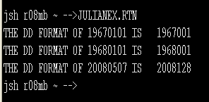
JULDATE
Output:

Slide 120
GET.LOC.REF & MULTI.GET.LOC.REF
GET.LOC.REF
Syntax:
CALL GET.LOC.REF(APPLICATION,FIELD.ARR,FIELDPOS)
Example:
CALL GET.LOC.REF("MG.MORTGAGE", "OB.DEPT.CODE", POS.DEPT.CODE)
FN.CUSTOMER = "F.CUSTOMER"
F.CUSTOMER = ""
CALL OPF(FN.CUSTOMER, F.CUSTOMER)
ID.CUST = R.NEW(MG.CUSTOMER)
CALL F.READ(FN.CUSTOMER, ID.CUST, R.CUST, F.CUSTOMER, ERR.CUST)
IF R.NEW(MG.LOCAL.REF)<1,POS.DEPT.CODE> = "" THEN
R.NEW(MG.LOCAL.REF)<1,POS.DEPT.CODE> = R.CUST<EB.CUS.POST.CODE>
END

Slide 121
GET.LOC.REF & MULTI.GET.LOC.REF – Contd…
MULTI.GET.LOC.REF
Syntax:
CALL MULTI.GET.LOC.REF(APPLICATION,FIELD.ARR,FIELDPOS)
Example:
APPL = "CUSTOMER“
FIELDS.ARR = "INSEE.COMM.NAIS":VM:"PAYS.NAISSANCE”
FIELDPOS = ''
CALL MULTI.GET.LOC.REF(APPL,FIELDS.ARR,FIELDPOS)
INS.COM.POS = FIELDPOS<1,1>
PAY.NAIS.POS = FIELDPOS<1,2>

Slide 122
Q & A
Thank you for your attention

